Slide 1
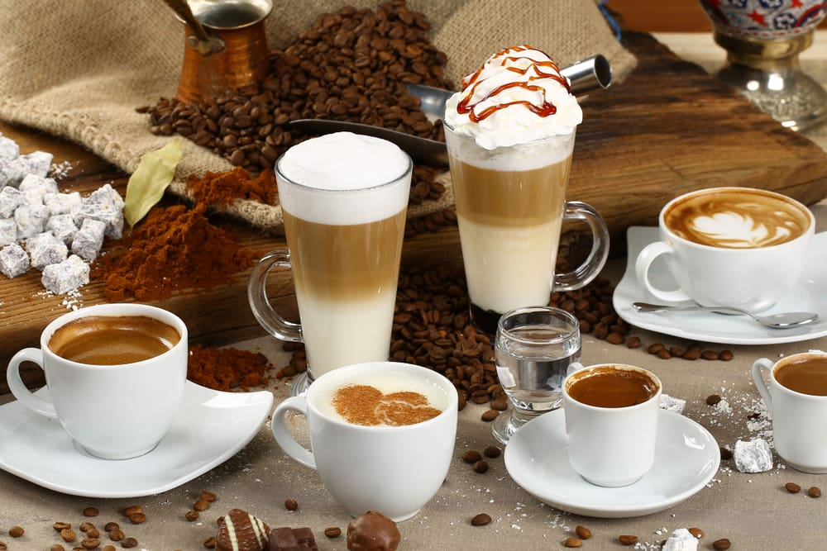

BRIGHT COFFEE SHOP
SALES PRESNTATION

Slide 2
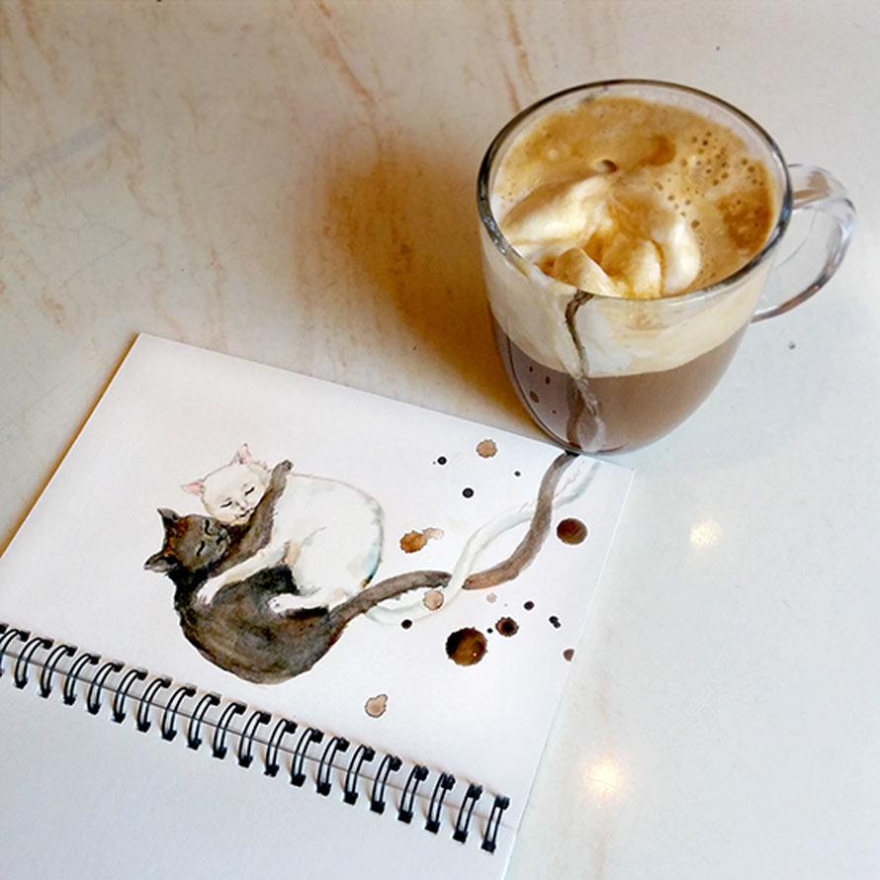
Designer helps you get your point across
Good morning, everyone.
Imagine, for a moment, the comforting hum of your favourite coffee shop. The rich aroma of freshly brewed beans, the gentle clinking of mugs, and that perfect, cozy ambiance.
It's a place where ideas brew, conversations flow, and inspiration often strikes.
Today, we're going to bottle a bit of that magic and bring it right here.
So, grab your imaginary latte, settle in, and let's begin.
This Photo by Unknown Author is licensed under CC BY-NC-ND

Slide 3
Top performing company products

Slide 4
Less performing company products

Slide 5
Recommendations
Business Recommendations for Bright Coffee Shop Based on the analysis of our sales data, here are strategic recommendations to assist the CEO in deciding the way forward for the business:
Strategies to Promote Underperforming Products To boost sales of lower-performing items, consider the following approaches:
Bundling Offers: Pair underperforming products (e.g., "Regular Syrup," "Sugar Free Vanilla syrup") with best-selling items at a slightly discounted price. For example, "Buy a Large Colombian Medium Roast and get a flavoured syrup for half price.
"Limited-Time Promotions: Introduce special "Flavour of the Week" or "Syrup Spotlight" promotions with new, enticing recipes using these products.
Upselling and Cross-selling by Baristas: Train staff to actively suggest adding a particular syrup or a less popular coffee bean type when customers order.
Visual Merchandising: Give more prominent display space to less popular coffee beans or syrups, perhaps with attractive signage explaining their unique flavour profiles or uses.
Tasting Samples: Offer small samples of beverages made with less popular syrups or new coffee bean roasts to encourage trial.
Loyalty Program Incentives: Offer bonus loyalty points for purchasing specific underperforming products.

Slide 6
Recommendations
8. Marketing Campaigns for Slow-Time Slots
Leveraging the insights from sales by 30-minute intervals, targeted campaigns can revitalize slow periods:
Identify Slow Periods: First, analyse your actual "Sales by Product Category and 30-Minute Intervals" data to pinpoint precisely when the foot traffic and sales are consistently low (e.g., mid-morning lull, late afternoon).
Happy Hour Deals: Implement specific "Happy Hour" promotions during slow times, offering discounts on certain beverages or food items. For example, "20% off all brewed coffee between 2:00 PM - 4:00 PM.
"Coffee & Co-work" Specials: Target remote workers or students with discounts on larger coffee sizes or combo deals (e.g., coffee + pastry) during typical working hours' slow spots.
Promote free Wi-Fi and comfortable seating. Afternoon Pick-Me-Up: Introduce special afternoon snack and drink combinations that are appealing to those needing an energy boost. Themed Days/Events: Host small, engaging events like "Board Game Tuesdays" or "Open Mic Wednesdays" during historically slow evenings to draw a crowd. Mobile Order/Delivery Incentives: Offer exclusive discounts or free delivery for orders placed via a mobile app during off-peak hours to encourage pre-orders or delivery.

Slide 7
Recommendations
9. Optimizing Stock for Best-Selling Items: Ensuring consistent availability of your top performers is crucial for customer satisfaction and sustained revenue. Prioritize Inventory: Based on the "Best-Selling Product Details by Total Quantity Sold" and "Best-Selling Product Types by Total Quantity Sold" (e.g., "Regular Espresso Shot," "Latte Rag," "Gourmet brewed coffee"), make these items top priority for inventory management. Set Higher Reorder Points: Implement higher reorder points and larger order quantities for your best-selling items to minimize out-of-stock situations. Supplier Relationships: Foster strong relationships with suppliers of key ingredients for these popular items to ensure reliable and timely deliveries. Monitor Trends Continuously: Regularly re-evaluate your best-selling lists (e.g., monthly or quarterly) as customer preferences can shift. Storage Optimization: Ensure you have adequate and efficient storage for high-volume items to avoid spoilage or damage. By implementing these data-driven recommendations, the Bright Coffee Shop can strategically improve product performance, optimize sales during slower periods, and ensure that popular items are always in stock, ultimately contributing to sustained business growth.

Slide 8
Monthly revenue by product

Slide 9
Revenue by store location

